Slide 1
Construction Technology

Slide 2
Construction Technology
Construction technology refers to the collection of innovative tools, machinery, modifications, software, used during the construction phase of a project that enables advancement in the field of construction methods, including semi-automated and automated construction equipment. Construction technology is used for all kinds of different projects, ranging from small residential houses to massive industrial plants.

Slide 3
Types of Construction Technologies
Construction industry includes a wide range of constructions suitable for all classes of society. Commercial construction, domestic construction, industrial construction, heavy or civil constructions are a few examples that are now displaying master pieces of construction technologies. Each of these requires different technological treatments.

Slide 4
Types of Construction Technologies
For domestic construction, simple technological methods are usually preferred and frequently available materials are mostly used. These are mostly low cost projects and are also short-term. In commercial construction, the basic concern is infrastructure that is responsible for strength and life of project. These are mostly launched by government agencies. These projects require latest construction technologies, equipment, and materials.

Slide 5
Role of Technology in Building Designs
With the passage of time, construction industry has passed through advancements. One of them is emphasis on designing buildings before practically constructing these buildings. Progress in technology has introduced successful techniques to develop strong and long lasting buildings. Development in the field of IT has become the main source for latest designing approach in construction technologies.

Slide 6
Role of Technology in Building Designs
Building Information Modeling (BIM) is one of such computerized systems that facilitate for collecting information about buildings under construction on regular basis. This system greatly enhances the communication among engineers and designers that are working on the project. Computer aided designing helps in designing flawless buildings as through computer simulations problems can be found and resolved before constructing buildings physically.

Slide 7
Innovations in Construction Technology
Technological progress has introduced many innovations in field of construction industry. There is huge difference between new and old construction methods. Use of latest machinery has made its way through the civil engineering. Most of the building parts such as pillars, roofs, and concrete blocks are available in prepared forms that increase the speed of construction process greatly. Use of pre-stressed concrete and beams strengthen the buildings along with speedy construction.

Slide 8
MATERIALS OF CONSTRUCTION

Slide 9
Introduction
All the building structures are composed of different
types of materials.
These materials are either called building materials or materials of construction.
The material cost in a building ranges 30 to 50 percent cost of total cost Project.

Slide 10
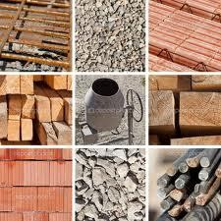
Building materials
Stone
Bricks
Lime
Cement
Sand
Aggregate

Slide 11
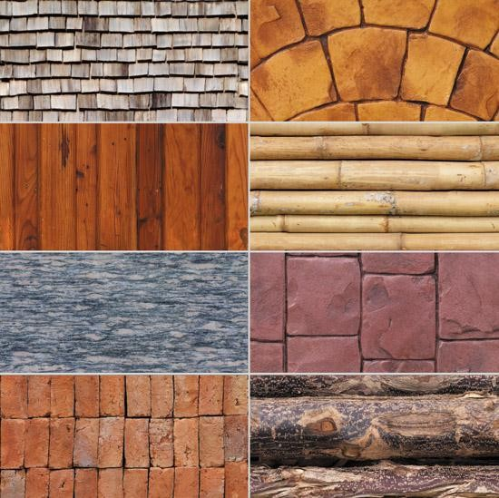
Building materials
Mortar
Concrete
Other civil engineering materials
11

Slide 12
Building Construction Materials
Building materials have an important role to play in this modern age of technology. Although their most important use is in construction activities. No field of engineering is conceivable without their use. Also, the building materials industry is an important contributor in our national economy as its output governs both the rate and the quality of construction work.

Slide 13
Building Construction Materials
There are certain general factors which affect the choice of materials for particular scheme. Perhaps the most important of these is the climatic background. Obviously, different materials and forms of construction have developed in different parts of the world as a result of climatic differences.
Another factor is the economic aspect of the choice of materials.

Slide 14
Wood
Clay/Soil
Natural
Rock
Gravel Cement Lime Bricks Stones
Construction
Materials
Artificial
Ceramics
Glass
Paints and Varnishes
Plastics
Tiles, marble, granites
5

Slide 15
Mechanical properties of materials
Strength
Elasticity
Plasticity
Ductility
Brittleness
Malleability
Toughness
Hardness
Stiffness
Creep
11. Fatigue strength

Slide 16
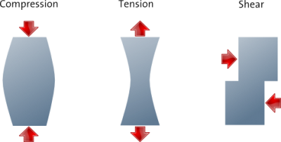
Strength
The capacity of material to withstand load is called
Strength or ability to withstand an applied stress without failure
Compressive strength, capacity to withstand axially directed
pushing forces
Tensile strength, maximum stress while being stretched or pulled
Shear strength, the ability to withstand shearing

Slide 17
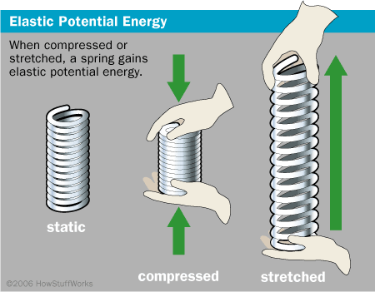
Elasticity
On a material when external load is applied it undergoes deformation and on removal of the load, it returns to it’s original shape.

Slide 18
Plasticity:
If a material does not regain its original shape, on removal of the external load, its called plastic materials.

Slide 19
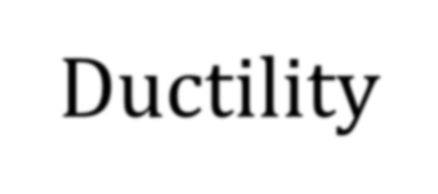
Ductility
If a materials can undergo a considerable deformation without rupture it is called a ductile materials.
E.g. steel, copper, wrought iron, aluminum alloys are ductile materials.

Slide 20
Brittleness
If a material can not undergo any deformation when some external force act on it and it fails by rupture.
Stronger in compression and weak in tension.
e.g. glass, concrete, bricks

Slide 21
Malleability
Malleability is a substance's ability to deform under pressure. If malleable, a material may be flattened into thin sheets by hammering or rolling
Gold, silver, copper, aluminum, Tin, Lead steel etc.

Slide 22
Toughness
Capacity of a material to absorb energy before rupture is called toughness.
Mild steel, wrought iron, etc.

Slide 23
Hardness
Hardness refers to the property of a material to resist pressing-in or scratch of a sharp object.
C.I is hardest material

Slide 24
Stiffness
Force required to produce unit deformation in a material is called stiffness.

Slide 25
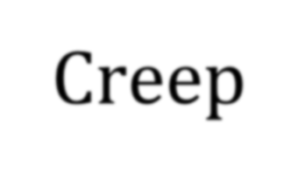
Creep
Permanent deformation of material due to sustained load is known as creep.

